Slide 1













The OpenSearch Metadata-Hub
Search engine based on OpenSearch
Automatic transfer between OpenSearch and MdH
More than 1000 metadata tags and 400 file types

Slide 3
Table of contents
01
02
03
Overview
Project Requirements
Architecture

Slide 4
01
Overview →

Slide 5
The OpenSearch Metadata-Hub
Search engine based on OpenSearch
Automatic transfer between OpenSearch and MdH
More than 1000 metadata tags and 400 file types

Slide 6
02
Project Requirements →

Slide 7




Project Requirements
Open Search
Metadata Hub
Easy to use
Accessible to everyone
Highly performant search through the use of Open Search
Enable searching throughout the complete Metadata Hub
System is easy to use and requires no technical knowledge
The system runs as a website and is accessible for everyone

Slide 8
03
Architecture →

Slide 9
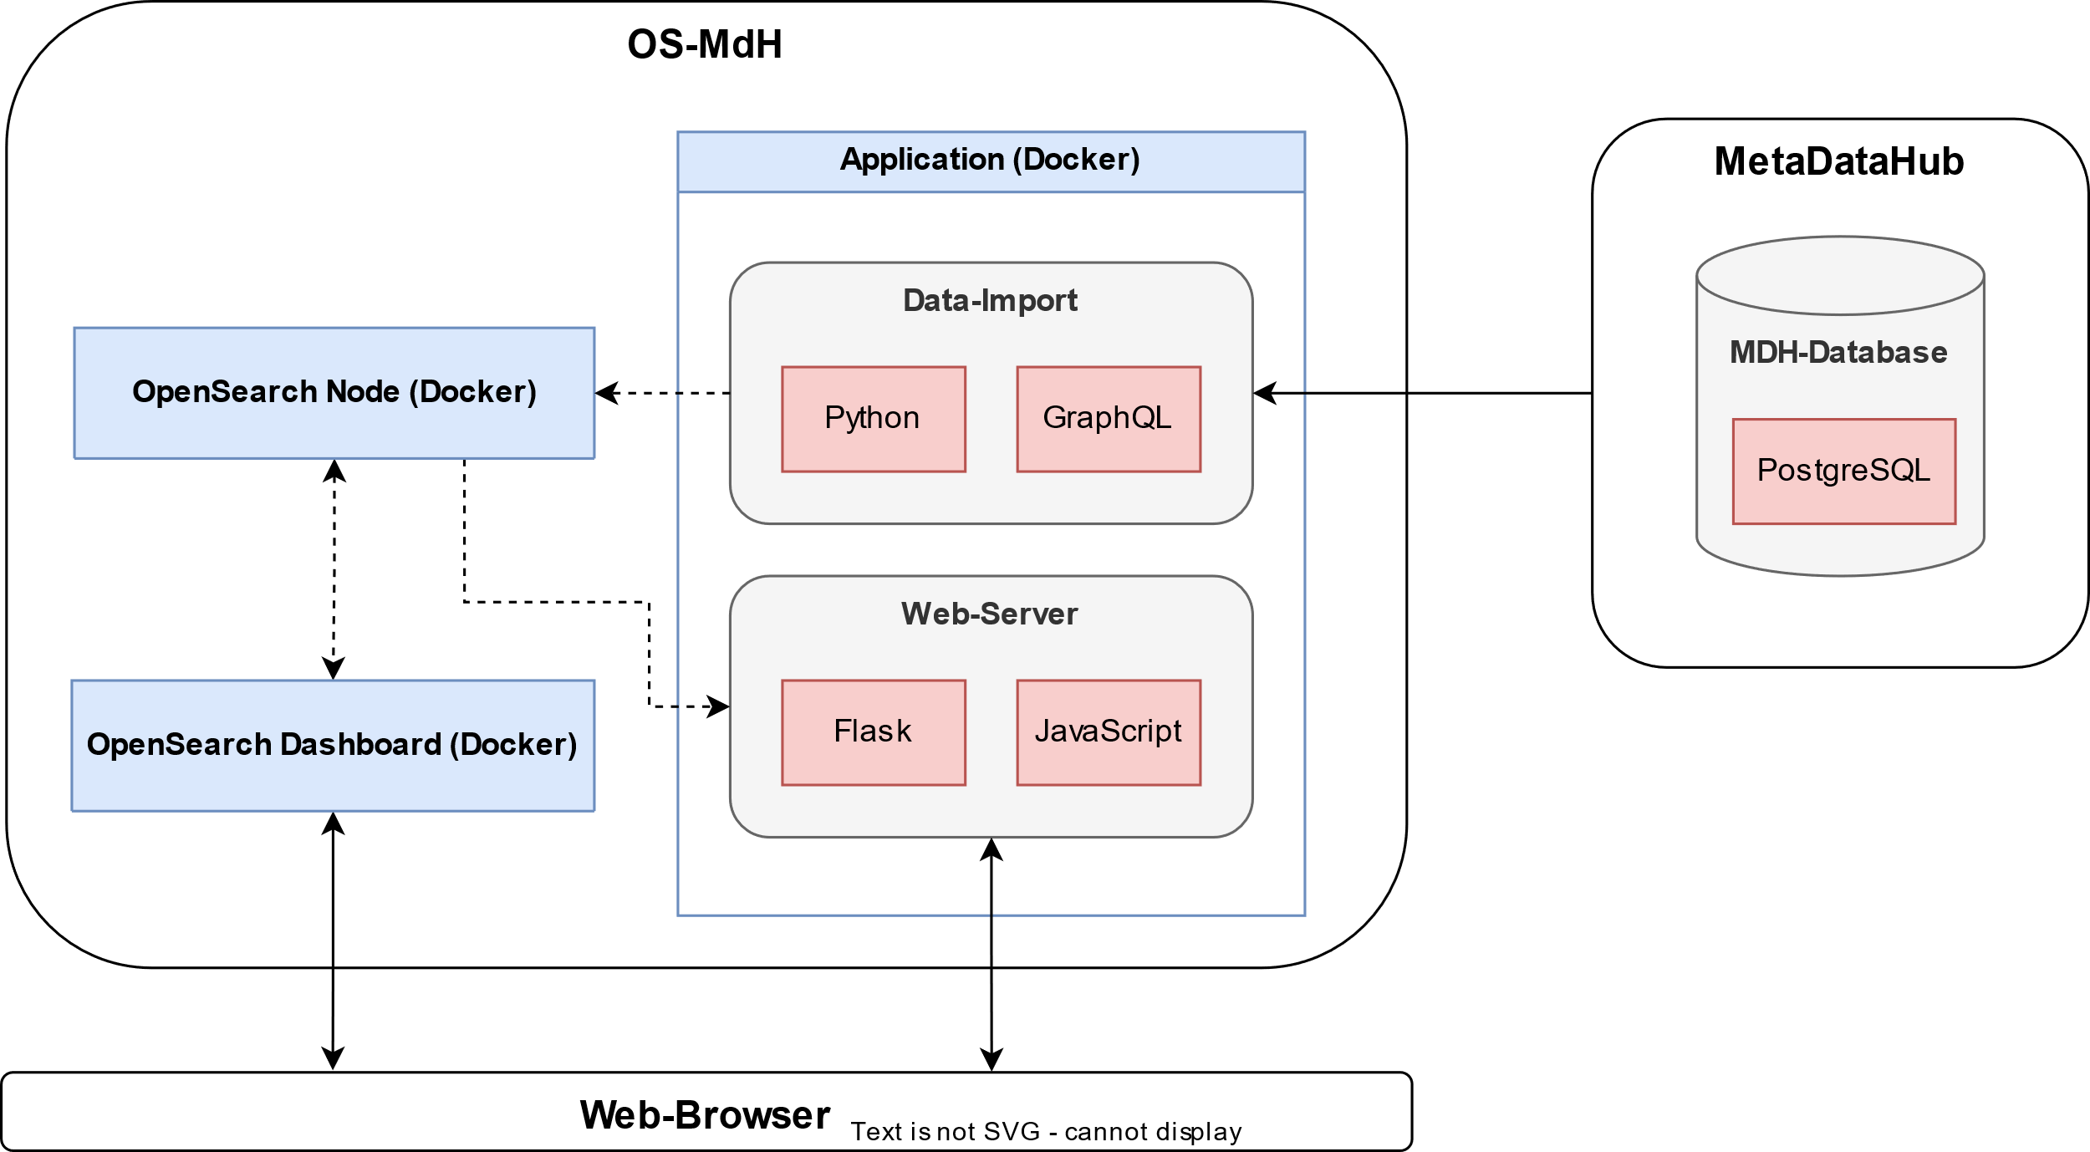
Architecture

Slide 10
Thank you for your attention!
Any questions?

